Slide 1

External Project Viva-Voice
Batch No: AB1
Project Title: Talk2Invoice: AI-Powered Voice Assistant for Food Ordering Using Whisper and DistilBERT
S.No | Reg.No | Student Name
1 | 22A81A6170 | BANDI POORNA SRI SAILAJA
2 | 22A81A61D0 | YAMANA BALAJI AKSHAY KUMAR
3 | 22A81A61B3 | PULAGAM SANTHOSHINI
4 | 22A81A6173 | BORRA VIKASH
5 | 22A81A6178 | CHITTIDI KAVYA LIKHITA
6 | 23A85A6114 | YERUWAKA RAM DURGA PRASAD
Project Guide:
Dr. Aswani Kumar E

Slide 2
MAJOR PROJECT REVIEW 1-CONTENTS
Abstract
Introduction
Literature Survey
Problem Statement in Existing System
Proposed System
Objective
Project domain
Requirement analysis
- Functional Requirements
- Non-Functional Requirements
- Software Requirements
- Hardware Requirements
System Architecture
Methodology
Design
Implementation
Result
Attainment of objective
Conclusion
Future scope of Project

Slide 3
Abstract
Artificial intelligence is being adopted more in fast-food service environments to make ordering quicker and easier, especially in busy places like metro stations, airports, and self-service kiosks. However, many current solutions don’t meet expectations due to limited voice recognition, lack of real-time inventory updates, and inadequate backend systems. Talk2Invoice is a voice assistant powered by AI that aims to solve these issues by allowing contactless food ordering through natural speech and automating backend tasks. Multilingual voice input is turned into text using OpenAI’s Whisper model, and customer intent along with food item details is identified using a fine-tuned DistilBERT model. QR code-based menu access makes interactions simpler, while a blockchain- enabled backend supports real-time stock management, queue optimization, and secure digital transactions. Once the order is confirmed successfully, digital invoices are automatically generated and sent to users, and analytical reports provide insights into sales trends and service performance. Experimental results show improved order accuracy in noisy settings, and better transparency in transaction handling. By combining speech processing, natural language understanding, and secure backend technologies, Talk2Invoice presents a practical, scalable, and user-friendly method for AI- driven food ordering in modern service environments.
Keywords: Voice Assistant, Speech-to-Text, Whisper (Faster Whisper), DistilBERT, Natural Language Processing, Real-Time Inventory Management, Digital Invoicing, Blockchain

Slide 4
Introduction
AI-Driven Service Transformation: Modern quick-service environments need intelligent automation to manage high customer volumes efficiently while keeping service accurate and scalable.
Limitations of Existing Ordering Systems: Manual counters and touchscreen kiosks face challenges during peak hours, including order inaccuracies, limited support for multiple languages, and poor backend synchronization.
Proposed Framework, Talk2Invoice: A new AI-powered voice ordering and invoicing system designed for real-world settings using deep learning models.
Core Technical Innovation: The system integrates Whisper for strong multilingual speech recognition and fine-tuned DistilBERT for intent detection and entity extraction. It is supported by real-time inventory and billing automation.
Research Contribution & Impact: It improves order accuracy, enables contactless transactions, and introduces secure, clear billing. This shows how AI can provide a scalable solution for smart food service systems.

Slide 5
Literature Survey
S.NO | TITLE | YEAR | INTRODUCTION | METHOD | RESULTS | DRAWBACKS
1 | Voice Assistant for Fast Food Restaurants using DistilBERT | 2024 | This study explores the use of fine-tuned DistilBERT-based voice assistants to enhance order speed, accuracy, and user interaction in fast-food environments. | The voice assistant employs a fine-tuned DistilBERT model for intent recognition using fast-food menu data. Google TTS/STT libraries enable speech conversion, while MongoDB stores inputs and menu data, supporting both order processing and model updates. The system achieved 95% accuracy post-tuning. | The voice-activated fast-food ordering assistant, powered by a fine-tuned DistilBERT model, achieved 95% accuracy in understanding customer queries—demonstrating its effectiveness in streamlining the order-taking process. | No explicit limitations discussed; focuses solely on system functionality without addressing drawbacks or challenges.
2 | Speech Oriented Virtual Restaurant Clerk using Web Speech API and Natural Language Processing | 29 May 2020 | Presents a voice-enabled virtual restaurant clerk using speech recognition, NLP, and biometrics to improve ordering workflows and enhance customer experience. | Implements a voice-based web app using Web Speech API, CNNs for speech and face recognition, and NLP via NLTK and spaCy; integrates a SQLite database and collaborative filtering for personalized food recommendations. | Demonstrates successful digitization of restaurant services with 89% face recognition accuracy, effective speech recognition, hands-free voice navigation, order tracking, and flexible payment options to enhance user experience and accessibility. | Relies on predefined dialogues with limited NLP flexibility, uses Web Speech API instead of native ASR, lacks mobile support,
3 | HYLR-FO: Hybrid Approach Using Language Models and Rule-Based Systems for On-Device Food Ordering | 2025 | The paper proposes HYLR-FO, an on-device food ordering system that combines lightweight language models with a rule-based system (RBS) to improve order accuracy ,flexible NLP handling, and order verification without relying on large LLMs or strong network connections. | Hybrid method using BERT/BART for order extraction, RBS for ASR error handling, tested on-device with 4000/1000 sample dataset, benchmarked vs GPT-4 & Gemini. | HYLR-FO combines a lightweight LM and RBS to achieve 86% order accuracy and 48× faster processing than LLMs, offering a fast, reliable on-device food ordering system suitable for resource-limited environments. | Relies on a custom dataset, which may limit generalizability; rule-based system may struggle with highly varied inputs; less accurate than LLMs in some cases.

Slide 6
Problem Statement In Existing System
In fast-food restaurants, especially in busy locations like metro stations, airports, and kiosks, order management often struggles to keep pace with high demand. Many outlets still rely on separate systems for order taking, inventory management, and analytics, leading to delays, and difficulty in coordinating kitchen operations. Voice ordering technologies, where used, often lack integration with real-time backend processes and can struggle to maintain accuracy in noisy environments. Most current platforms do not provide intelligent load balancing, instant stock checks, or secure, transparent transaction tracking. As a result, these systems fail to deliver a fully connected, efficient, and scalable solution that meets the needs of fast-paced food service environments.

Slide 7
Proposed System
The aim is to develop an advanced and intelligent food ordering system that overcomes the limitations of existing solutions in fast-food environments.
In the existing system, voice ordering platforms often work in isolation, with limited integration between order placement, inventory management, and backend analytics.
Talk2Invoice combines multilingual voice recognition, real-time inventory checks, kitchen load balancing, and secure transaction management into a single, scalable platform. It uses OpenAI’s Whisper for accurate speech-to-text conversion and a fine-tuned DistilBERT model for precise intent recognition and food item extraction. The system generates automated digital invoices and provides daily analytics reports, enabling restaurants to optimize operations, improve order accuracy, reduce wait times, and enhance customer satisfaction in high-traffic locations.

Slide 8
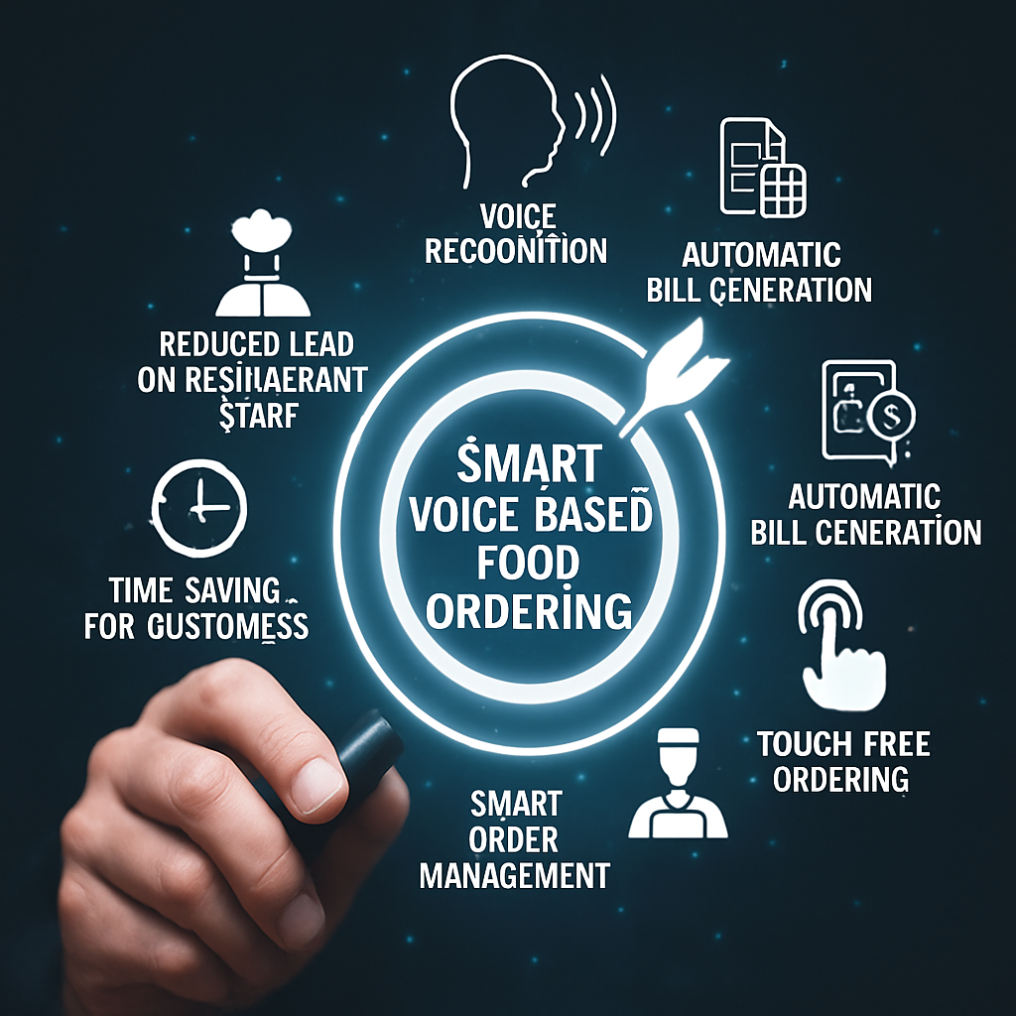
Objective
To transform the food ordering experience in fast-food environments by providing an intelligent, voice-enabled ordering service. The system delivers fast, accurate, and personalized order processing by leveraging multilingual speech recognition, natural language understanding, and real-time backend operations. It empowers both customers and restaurant operators with a seamless, efficient, and transparent ordering process, ultimately improving customer satisfaction, reducing wait times, and enhancing operational performance in high-demand locations.

Slide 9
Project domain
Domain: Artificial Intelligence (AI)
The core domain of this project is Artificial Intelligence (AI), specifically focusing on Natural Language Processing (NLP) and Speech Recognition to enable accurate, multilingual voice-based food ordering.
Key Areas within the Project Domain:
Speech Recognition (OpenAI’s Whisper): Converts multilingual speech into text with high accuracy, even in noisy environments.
Natural Language Processing (DistilBERT): Identifies user intent and extracts food order details from transcribed text.
Blockchain Integration: Provides a decentralized, secure ledger for transaction logging, inventory updates, and queue management.
AI-Driven Backend Automation: Handles real-time inventory checks, kitchen load balancing, and automated invoice generation.

Slide 10
Requirement Analysis
Functional Requirements
Voice Order Collection – Capture and process user voice orders along with preferences.
Speech-to-Text Processing – Use Whisper to convert multilingual speech to text accurately.
Intent Recognition – Apply DistilBERT to detect order intent and extract food items.
Inventory & Load Check – Verify stock and balance kitchen load in real time.
Blockchain Integration – Ensure secure order tracking and transaction logging.
Order Confirmation & Payment – Confirm order and enable secure payments.
Invoice Generation – Auto-create and send digital invoices to users.
Analytics & Learning – Generate daily reports and improve accuracy via feedback.
Non-Functional Requirements
Performance – Process multiple voice orders with low latency
2.Security – Encrypt user/order data; blockchain ensures secure transactions.
3.Reliability – Operate without crashes even under heavy load.
4.Usability – Provide a simple, natural voice interface for all users.

Slide 11

Software Requirements
Programming Language:
Python (core development and ML implementation)
Libraries/Frameworks:
OpenAI Whisper – Multilingual speech-to-text conversion
Transformers (HuggingFace) – For fine-tuned DistilBERT intent recognition
Flask / FastAPI – Backend REST API development
scikit-learn – Additional NLP or ML tasks
Web3.py – Ethereum blockchain integration
Matplotlib– Analytics dashboard visualization
Development Environment:
Jupyter Notebook
Google Colab
VS Code / PyCharm
Database:
MongoDB (Order, inventory, user management)
Hardware Requirements
Processors: Multi-core CPUs or GPUs for faster Whisper and NLP model execution
Memory (RAM):
Minimum 8 GB or Recommended 16 GB or more (for parallel processing and inference in real time)
Networking:
Stable internet for real-time Whisper API or self-hosted models
Local network (for deployment in kiosks or metro stations)

Slide 12

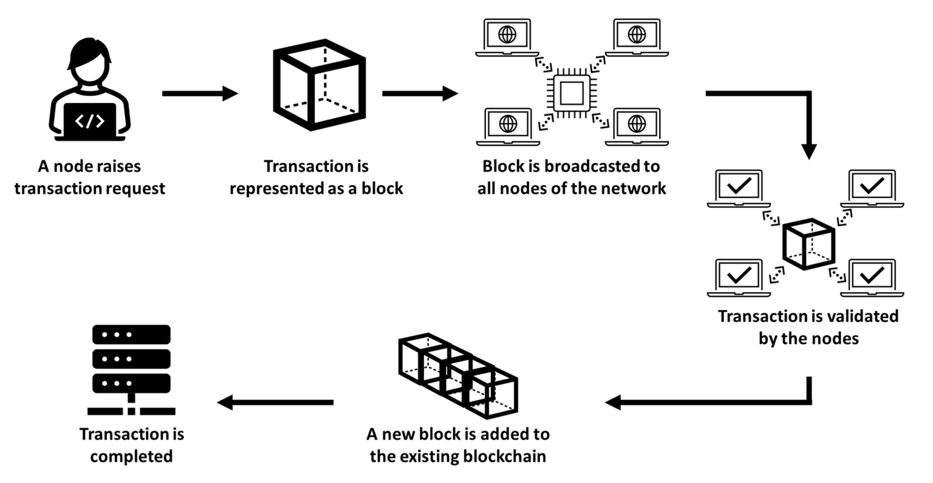
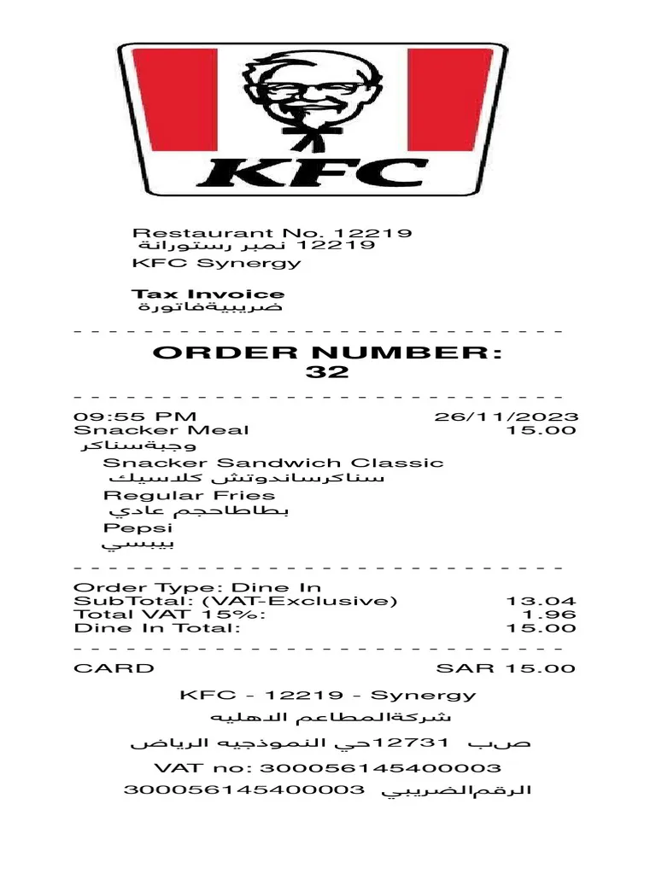
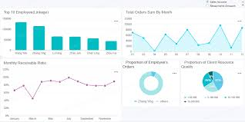

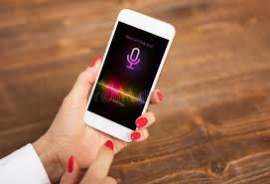

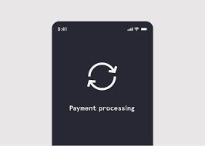


System Architecture
Inventory &
kitchen load check
Admin
Blockchain transaction management
Daily analysis
Voice input
Scan me

Slide 13
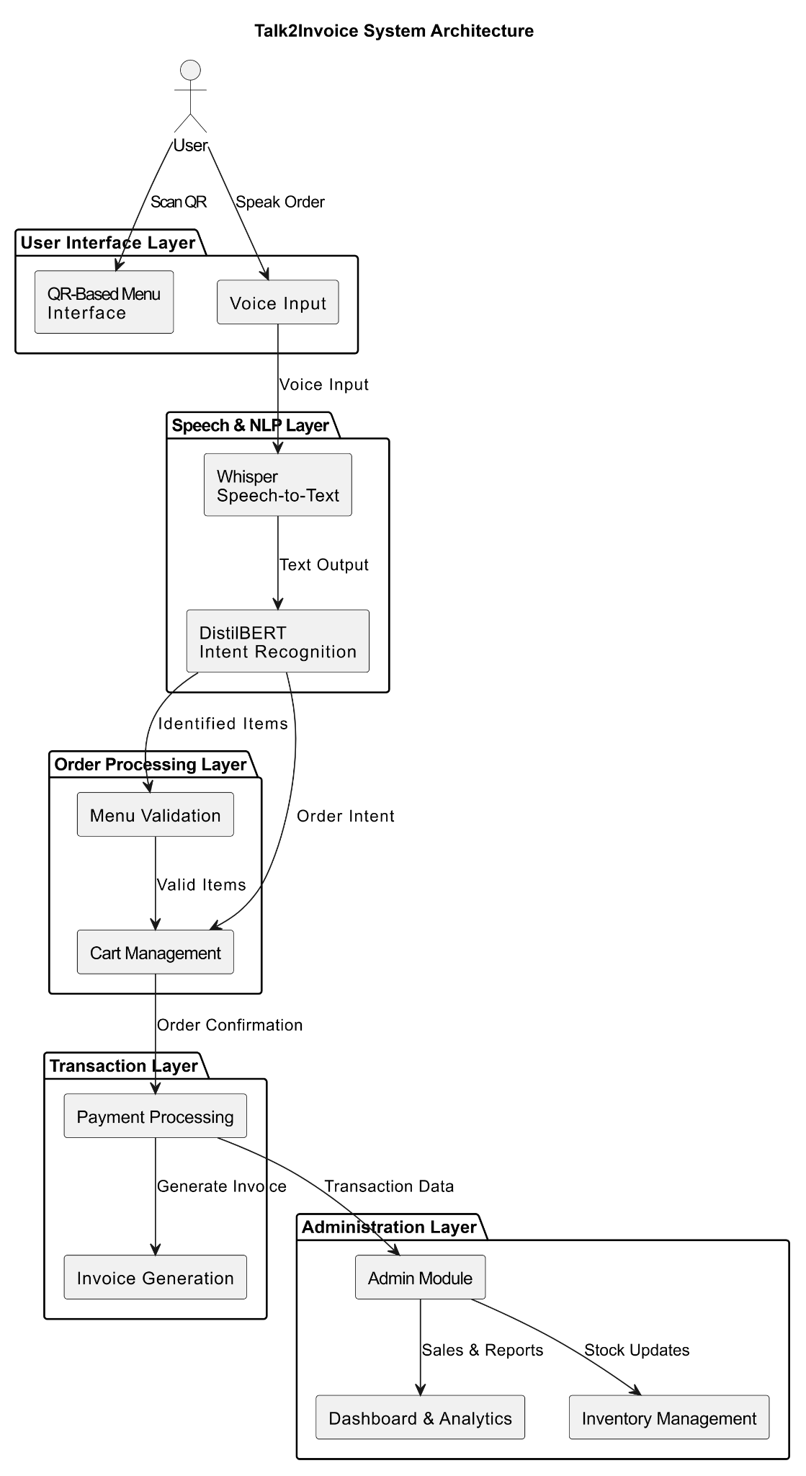
Methodology
Voice Interaction and Intent Processing: The QR-based web interface allows for app-free access. User speech is converted to text with Whisper, and a fine-tuned DistilBERT model handles intent recognition and item extraction with voice confirmation.
Order Processing and Smart Processing: The backend performs real-time inventory audits and analyzes kitchen workload. Only verified orders receive a unique ID and are processed to improve efficiency during busy times.
Secure Backend and Administration: Orders are stored in a central database, and transaction metadata is recorded on a blockchain ledger to ensure transparency and permanence. An electronic invoice is generated automatically.
Model Training and Evaluation: DistilBERT was trained with the AdamW optimizer (learning rate: 2e-5 to 5e-5, batch size 32) and used early stopping. It achieved 96.30% accuracy in intent recognition.

Slide 14
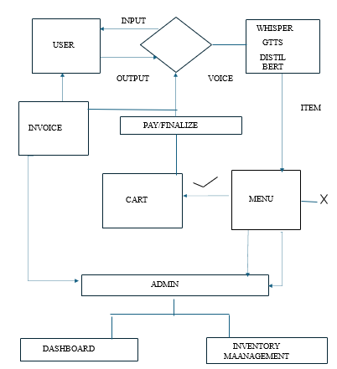
Design
voice

Slide 15
Implementation
1.Environment Setup:
Installed faster-whisper, DistilBERT, and FFmpeg for speech recognition, NLP, and audio processing.
Initialized Gemini API for advanced multilingual NLP.
Created persistent storage directories for orders and reports.
2. Data Modelling:
Defined MENU_DATA and RESTAURANT_INFO for menu, pricing, and GST details.
Used ITEM_MAPPINGS and NATIVE_COMMAND_MAP for natural and multilingual command recognition.
Implemented OrderManager to manage adding, removing, and finalizing orders.
3. Voice AI Pipeline:
Converted voice input to text using Whisper and classified intents via DistilBERT.
Used Gemini NLP for complex commands and text-to-speech for natural audio responses.
4.Reporting and Blockchain:
Generated digital invoices in PDF/HTML formats with GST details.
Logged all transactions in all_orders.json and secured them with blockchain simulation.
Integrated Pandas and Plotly for sales and performance analytics.
5.Interface and Event Handling:
Built a Gradio interface with separate views for customers and admins.
Enabled real-time order placement, inventory control, and analytics visualization.
Ensured seamless voice interaction and automated invoice generation.

Slide 16
Result & Analysis
Model Performance Validation
Accuracy: ~96%
Stable learning curve with consistent improvement across epochs.
The confirmation layer removed finalization errors.
Functional Results of the Validation
Accurate extraction of items and quantities
Successful handling of: - Single-item orders - Sequential orders (Multi-item).
Online rejection of out-of-stock products.
Effective kitchen load balancing during peak simulation.
Practices of Administrative and Transaction Transparency
Store order records are kept asymmetrically at the back end.
The administrative dashboard allows

Slide 17
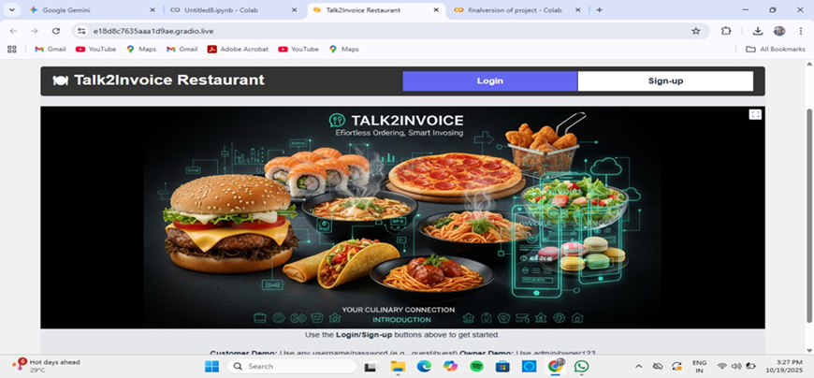
Login Page

Slide 18
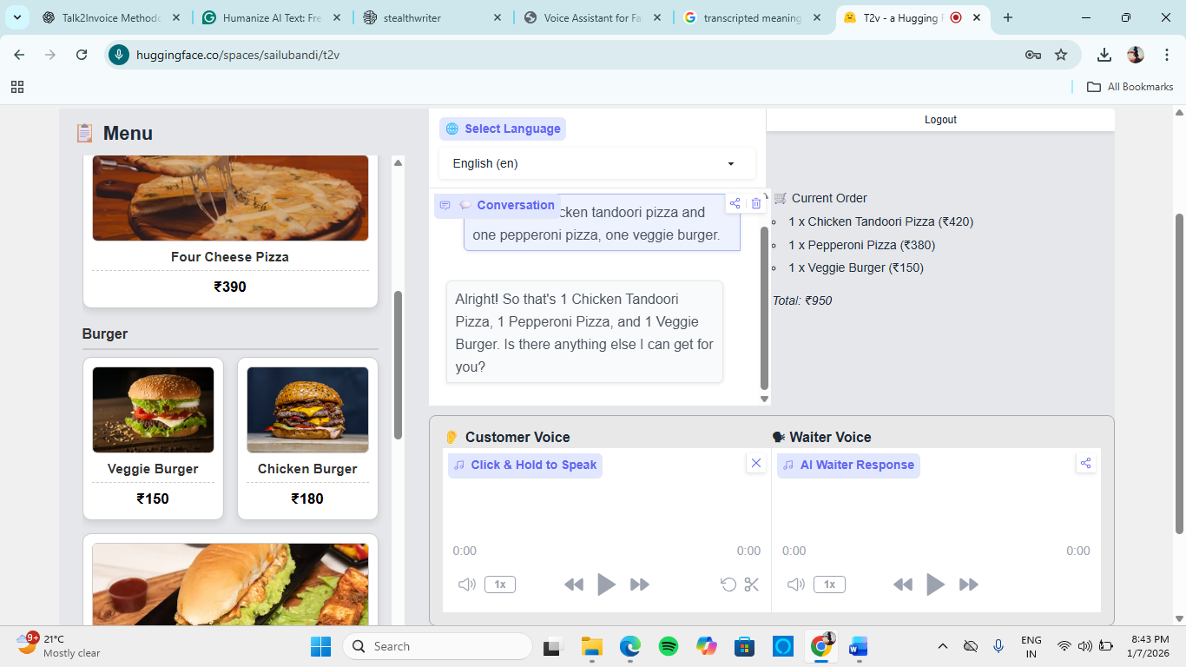
Menu & Ordering Page

Slide 19
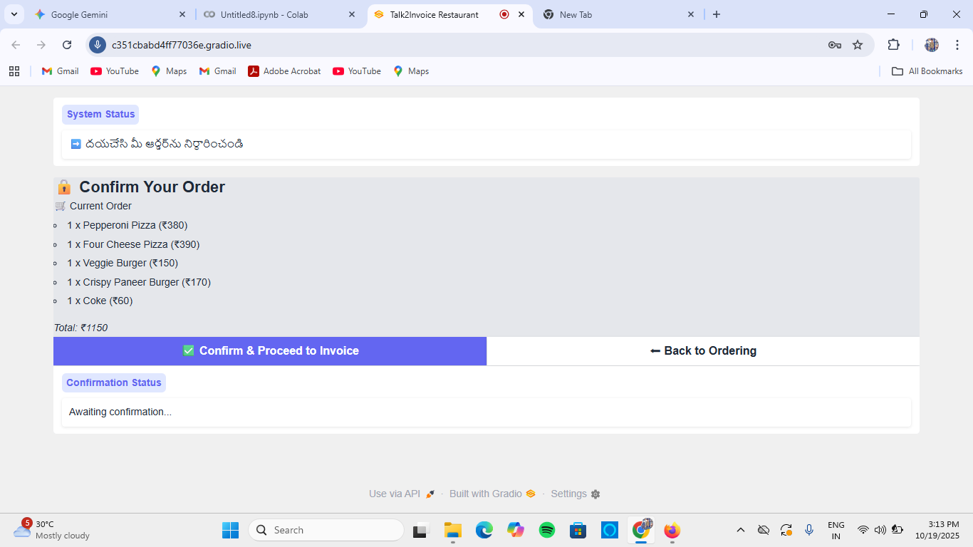
Confirmation page

Slide 20
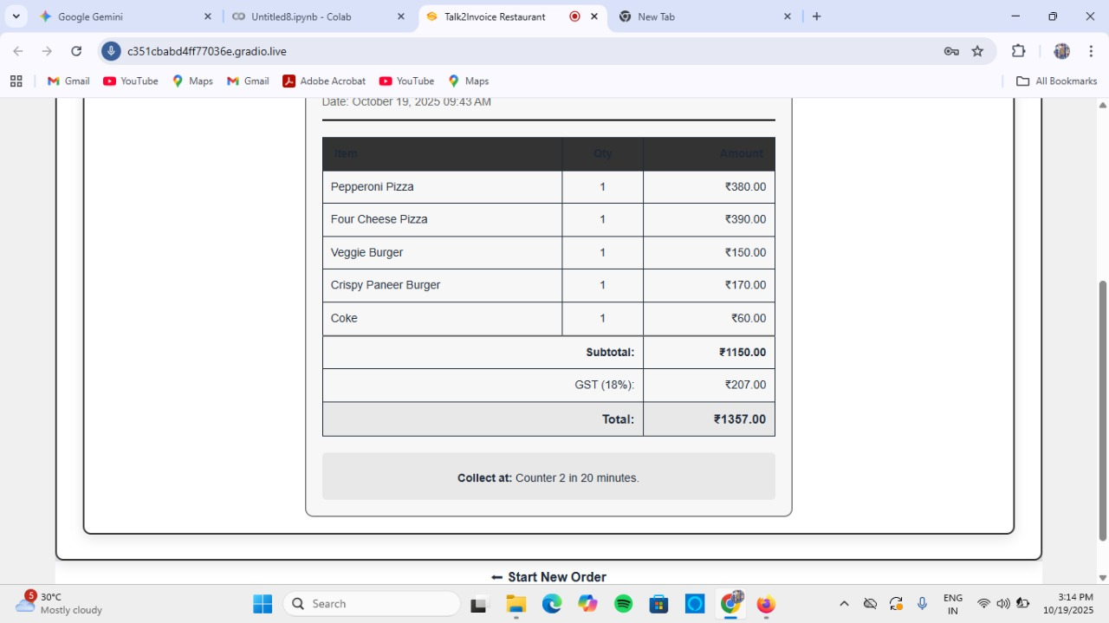
Invoice Generation

Slide 21
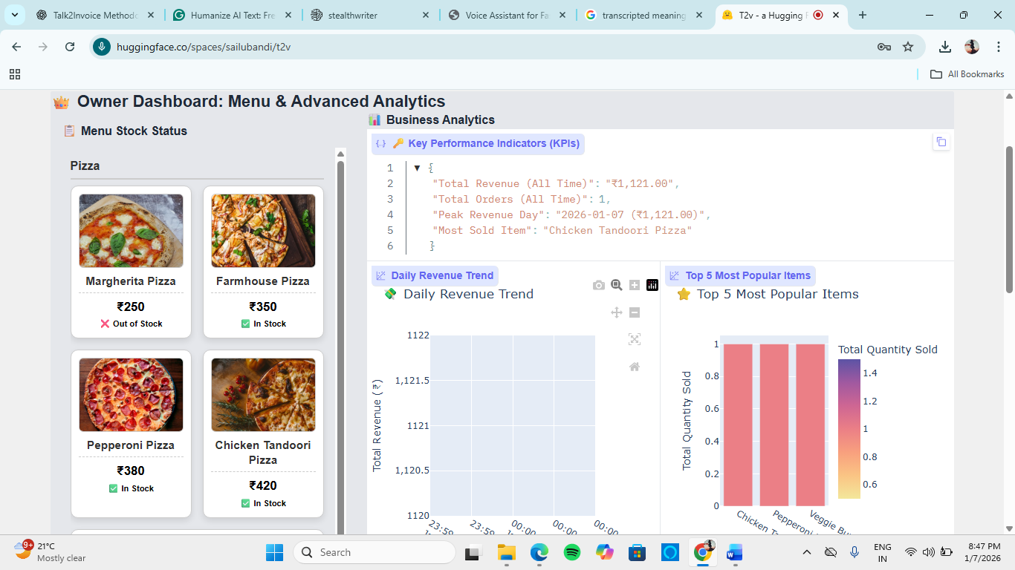
Owner Dashboard

Slide 22
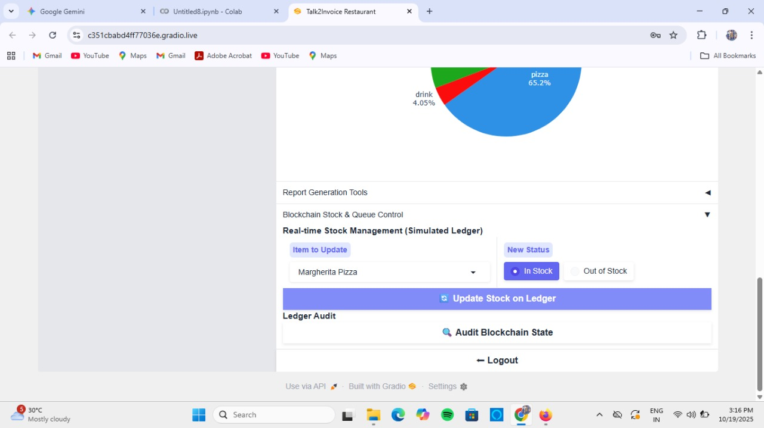
Real Time Stock Management

Slide 23
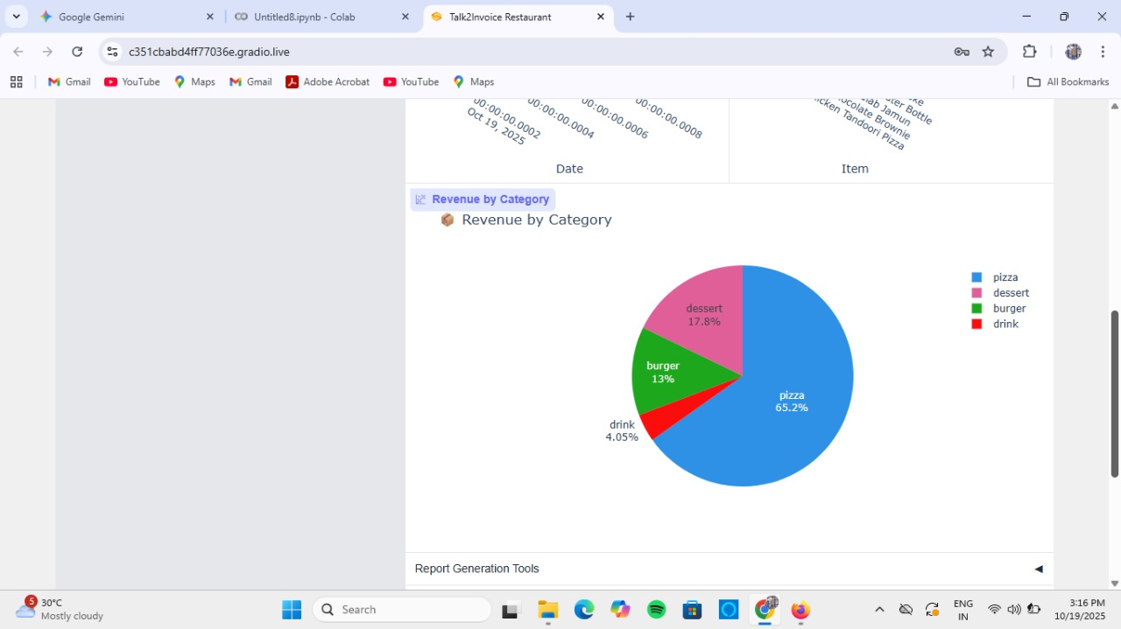
Revenue With Pie Chart

Slide 24
Attainment of objective
AI Voice Ordering
Enabled contactless ordering through Whisper for accurate, multilingual speech recognition.
Smart Intent Detection
Used DistilBERT to understand user voice and identify food items precisely.
Real-Time Order Management
Handled live inventory filtering, kitchen load balancing, and automatic invoice generation.
Secure Blockchain Integration
Added blockchain for transparent stock tracking and safe digital transactions.
Daily Analytics Generation
Automated backend analytics to monitor sales, service trends, and performance.

Slide 25
Conclusion
Talk2Invoice is an AI-powered voice ordering solution that transforms restaurant operations into a smart, contactless, and automated process. It integrates AI, NLP, Speech Recognition, and Blockchain to deliver fast, secure, and intelligent service. Whisper ensures accurate speech-to-text in noisy environments, while DistilBERT interprets user intent and menu selections. The backend automates menu management, inventory, and kitchen operations for real-time tracking and improved efficiency. The admin dashboard provides insights on sales, top items, and performance analytics. Customers enjoy multilingual voice support, quick ordering, and precise billing, enhancing satisfaction and reducing wait times. The system lowers staff workload, speeds up service, and supports eco-friendly practices by eliminating paper receipts. . Overall, Talk2Invoice represents a significant step toward next- generation, AI-powered, voice- interactive restaurant systems, setting a benchmark for innovation in the food industry.

Slide 26
Future Scope
The Talk2Invoice system has a wide range of future improvements and advanced features that
can make it even more intelligent, efficient, and user-friendly.
1. Offline Mode Support:
The system can be enhanced to work even without an internet connection. Orders can be stored locally and automatically synced once the network is restored. This ensures uninterrupted service even in areas with poor connectivity.
2. Emotion Detection in Voice:
Future versions can analyze the tone and emotion of the customer’s voice to provide more natural and personalized responses — for example, offering calm replies to frustrated users or cheerful interactions for happy customers.
3. Integration with Delivery Partners:
The system can be connected to online food delivery platforms such as Swiggy or Zomato for automated order dispatch, tracking, and delivery updates directly through voice commands.

Slide 27

Future Scope
The Talk2Invoice system has a wide range of future improvements and advanced features that
can make it even more intelligent, efficient, and user-friendly.
1. Offline Mode Support:
The system can be enhanced to work even without an internet connection. Orders can be stored locally and automatically synced once the network is restored. This ensures uninterrupted service even in areas with poor connectivity.
2. Emotion Detection in Voice:
Future versions can analyze the tone and emotion of the customer’s voice to provide more natural and personalized responses — for example, offering calm replies to frustrated users or cheerful interactions for happy customers.
3. Integration with Delivery Partners:
The system can be connected to online food delivery platforms such as Swiggy or Zomato for automated order dispatch, tracking, and delivery updates directly through voice commands.

